Slide 1
Indirect Visual Odometry with Optical Flow
Chenguang Huang, Andong Tan
München, 22. July 2019

Slide 2
Overview
1. Introduction
1.1 Lukas Kanade Method for Optical Flow
1.2 Project Pipeline
1.3 Parameter and Strategy
2. Evaluation
2.1 Precision Comparison
2.2 Execution Time Comparison
2.3 Visualization Comparison
3. Conclusion

Slide 3
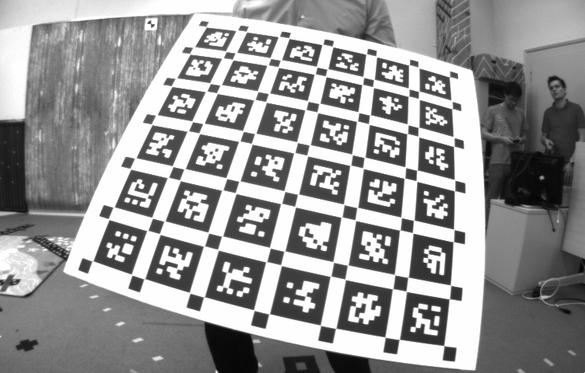
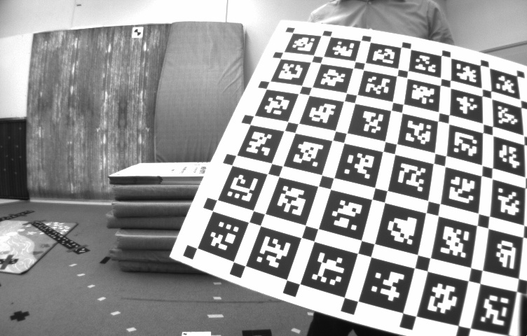
1 Introduction
1.1 Lukas Kanade method for optical flow
Input: two images, key points in one image
Output: the key points in the other image
Input key point position in one image
Output key point position in the other image

Slide 4
1 Introduction
1.1 Lukas Kanade method for optical flow
Inspiration in SLAM:
replace feature descriptors matching with optical flow method!
Input key point position in one image
Output key point position in the other image

Slide 5
1 Introduction
yes
Keyframe?
no
……
First image?
……
yes
no
……
……
……

Slide 6
1 Introduction
1.2 Project pipeline: first key frame
Step 1: detect key points in left image
Left image
Right image
Time 0

Slide 7
1 Introduction
1.2 Project pipeline: first key frame
Step 2: optical flow to right image
Left image
Right image
.
.
.
Time 0

Slide 8
1 Introduction
1.2 Project pipeline: first key frame
Step 3: check epipolar constraint and find inlier
Left image
Right image
Time 0

Slide 9
1 Introduction
1.2 Project pipeline: first key frame
Step 4: localize camera
Left image
Right image
Time 0

Slide 10
1 Introduction
1.2 Project pipeline: first key frame
Step 5: triangulate landmarks
Left image
Right image
Time 0

Slide 11
1 Introduction
1.2 Project pipeline: second and later key frame
Step 1: optical flow to next left frame
Left image
Right image
Time t-1
Time t

Slide 12
1 Introduction
1.2 Project pipeline: second and later key frame
Step 1: optical flow: backward check
Left image
Right image
Time t-1
abandon
Time t

Slide 13
1 Introduction
1.2 Project pipeline: second and later key frame
Step 2: make grid & detect key points in empty cells
Left image
Right image
Time t-1
Empty cells
Time t
Detect new
key points

Slide 14
1 Introduction
1.2 Project pipeline: second and later key frame
Step 3: optical flow to the right image
Left image
Right image
Time t-1
Newly detected
Compute from last frame
Time t

Slide 15
1 Introduction
1.2 Project pipeline: second and later key frame
Step 4: use epipolar constraint to find inliers
Left image
Right image
Time t-1
Newly detected
Compute from last frame
Time t
Inliers

Slide 16
1 Introduction
1.2 Project pipeline: second and later key frame
Step 5: localize camera
Left image
Right image
Time t-1
Use the key
points that
already has
landmarks
to localize
camera
Time t

Slide 17
1 Introduction
1.2 Project pipeline: second and later key frame
Step 6: add observation and create landmarks
Left image
Right image
Time t-1
Add observation
Create new
landmarks
Time t

Slide 18
1 Introduction
1.2 Project pipeline: non key frame
Step 1: optical flow to next frame
Left image
Right image
Time t-1
Time t

Slide 19
1 Introduction
1.2 Project pipeline: non key frame
Step 2: make grid & count empty cells
Left image
Right image
Key framing strategy
Time t-1
# empty cells
If greater than
threshold, make
next frame
key frame
Time t

Slide 20
1 Introduction
1.2 Project pipeline: non key frame
Step 3: localize camera
Left image
Right image
Time t-1
localize
camera
Time t

Slide 21
1 Introduction
1.3 Parameter and strategy
1.3.1 Grid shape: retangle vs square
pixel x pixel
30 x 47
32 x 32
rmse
0.14
0.11

Slide 22
1 Introduction
1.3 Parameter and strategy
1.3.2 Key points detection: in whole image vs in each cell
Detect in whole image
Detect in empty cells respectively
Then only keep key points in empty cells
rmse
0.1139
0.1116

Slide 23
1 Introduction
1.3 Parameter and strategy
1.3.3 Key framing: use grid vs use only inliers number
# empty cells
# localization inliers
If greater than
threshold, make
next frame
key frame
If smaller than
threshold, make
next frame
key frame
rmse
0.11
0.43

Slide 24
2 Evaluation

Slide 25
2 Evaluation
2.1 Precision comparison
Basic parameters
image height (pixel) | image width (pixel) | grid size (pixel x pixel)
480 | 752 | 32 x 32
Strategy
1. Square grid
2. Key points detection only in empty cell
3. Use number of empty cells to decide key frame

Slide 26
2 Evaluation
2.1 Precision comparison
Variation parameters: maximum empty cells percentage*
Max empty cells | 35% | 40% | 42% | 44% | 46% | Exercise 5
rmse | 0.1303 | 0.1295 | 0.1099 | 0.1563 | 0.1304 | 0.1012
*maximum empty cells percentage: when the empty cells percentage exceeds this
value and optimization is finished, make next frame key frame

Slide 27
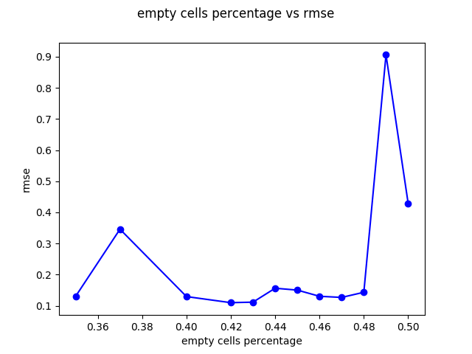
2 Evaluation
2.1 Precision comparison

Slide 28
2 Evaluation
2.2 Execution time comparison
2.2.1 Detection time
Max empty cells | 35% | 40% | 42% | 44% | 46% | Exercise 5
detection time (seconds) | 3.03643 | 2.73232 | 2.43286 | 2.62328 | 2.26326 | 44.0214

Slide 29
2 Evaluation
2.2 Execution time comparison
2.2.2 Optimization time
Max empty cells (%) | 0.42 | Exercise 5
Opt. time(s) | 305.043 | 65.8619
# landmarks | 290657 | 221886
# observation | 1939460 | 559563
# keyframe | 414 | 170

Slide 30
2 Evaluation
2.2 Execution time comparison
2.2.3 Frame to frame (f2f) optical flow time
Ex. 5 Feature Matching time(s) | 5.79
f2f optical flow time(s) | 117.4~143.1

Slide 31
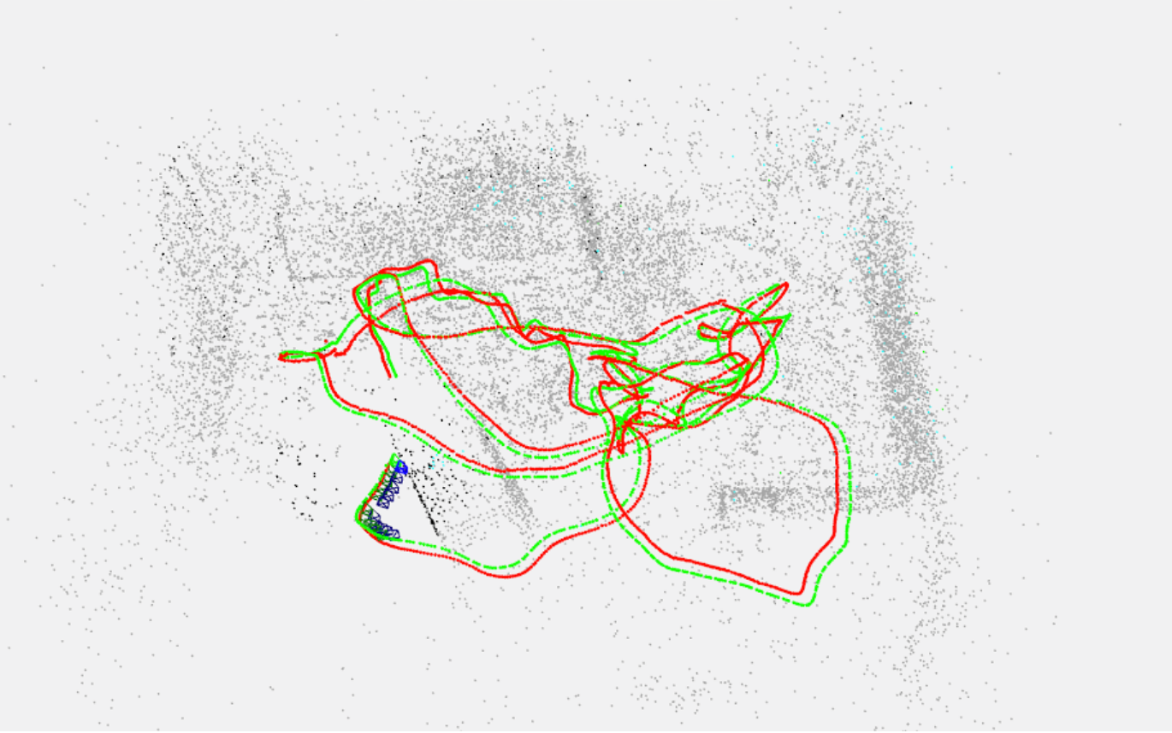
2 Evaluation
2.3 Visualization comparison
Maximum empty cells percentage: 42%

Slide 32
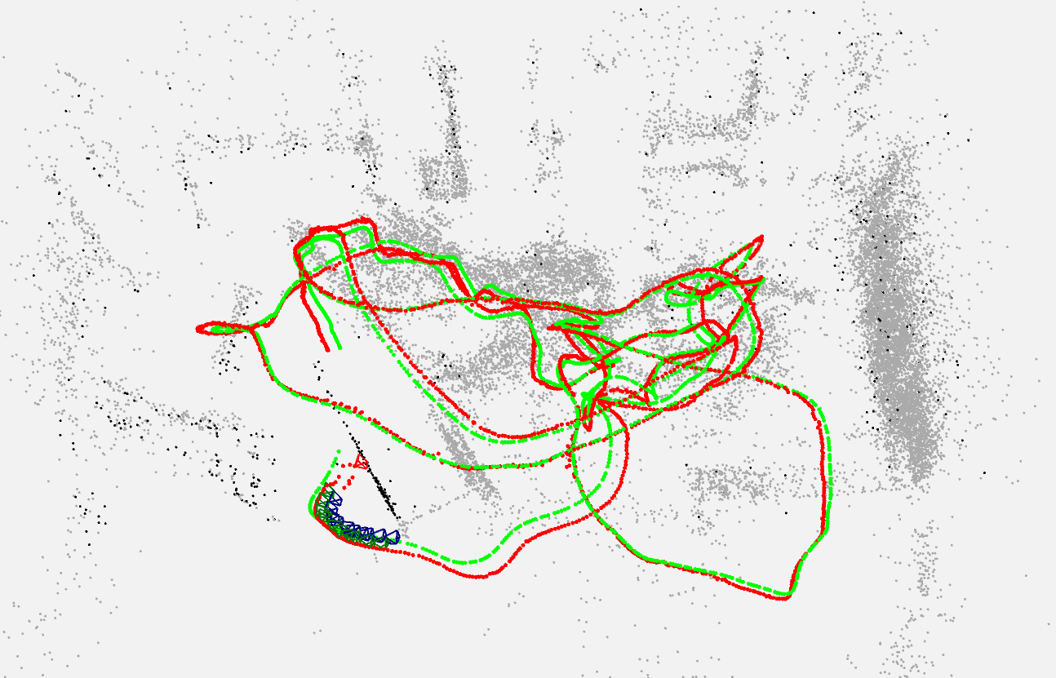
2 Evaluation
2.3 Visualization comparison
Exercise 5

Slide 33
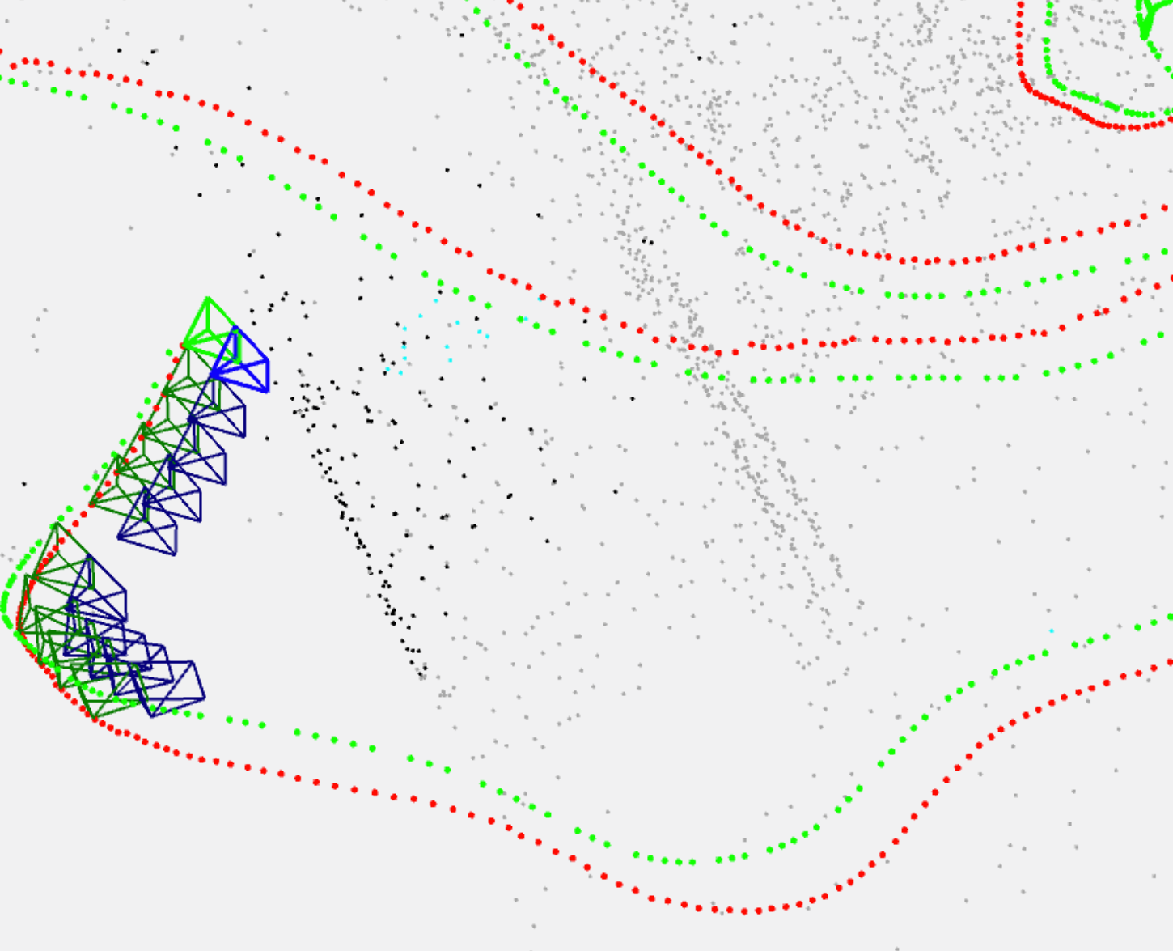
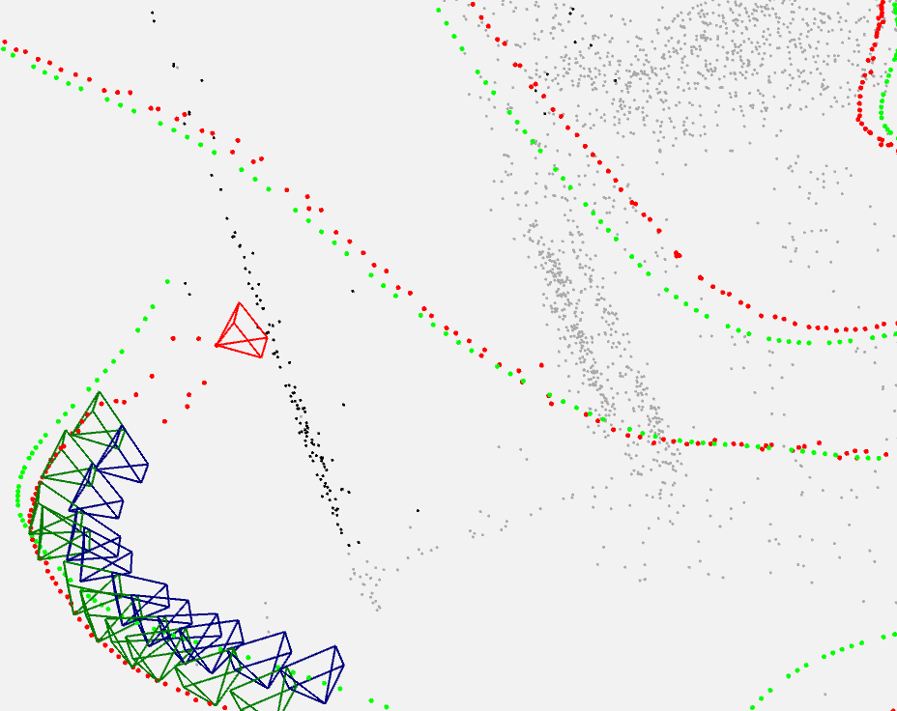
2 Evaluation
2.3 Visualization comparison
Maximum empty cells percentage: 42%
Exercise 5

Slide 34
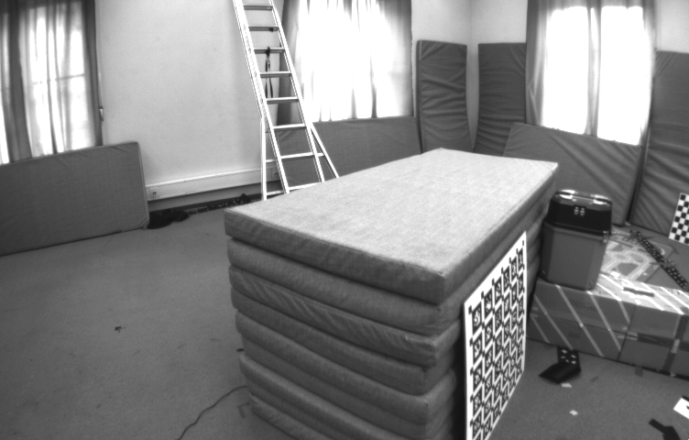
2 Evaluation
2.3 Visualization comparison

Slide 35
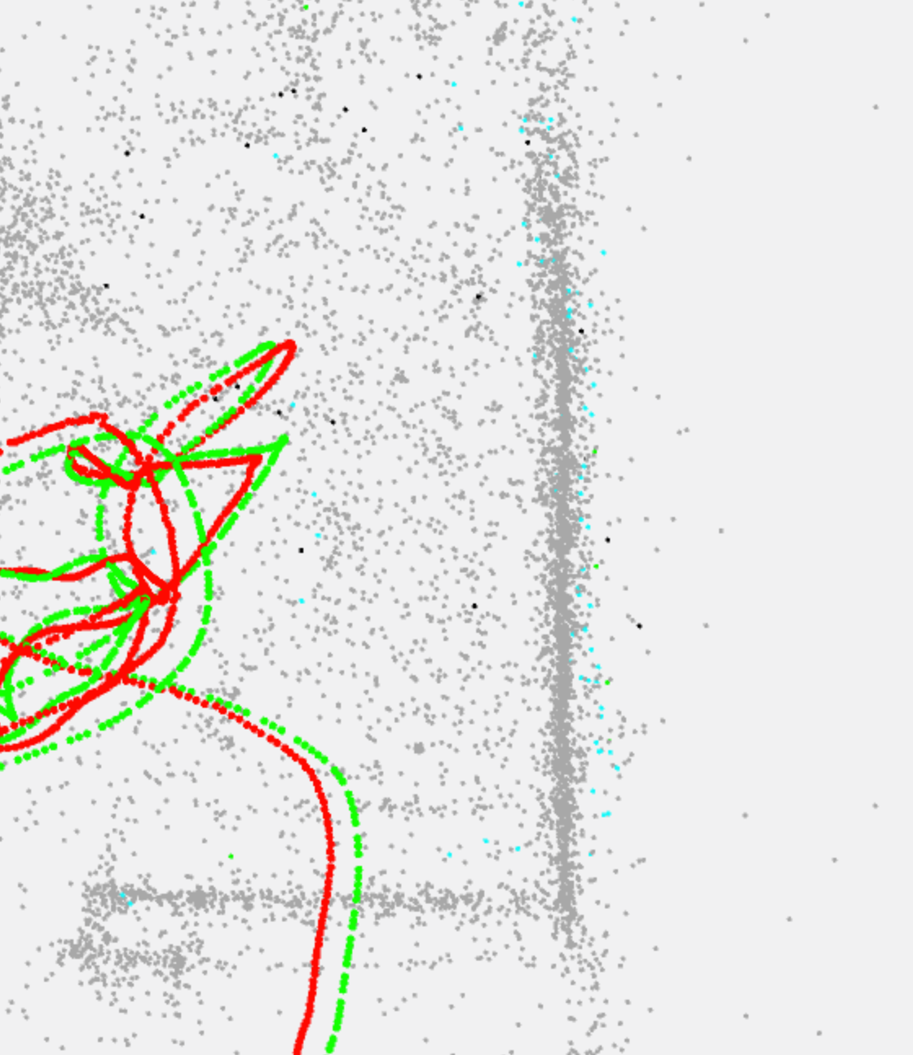
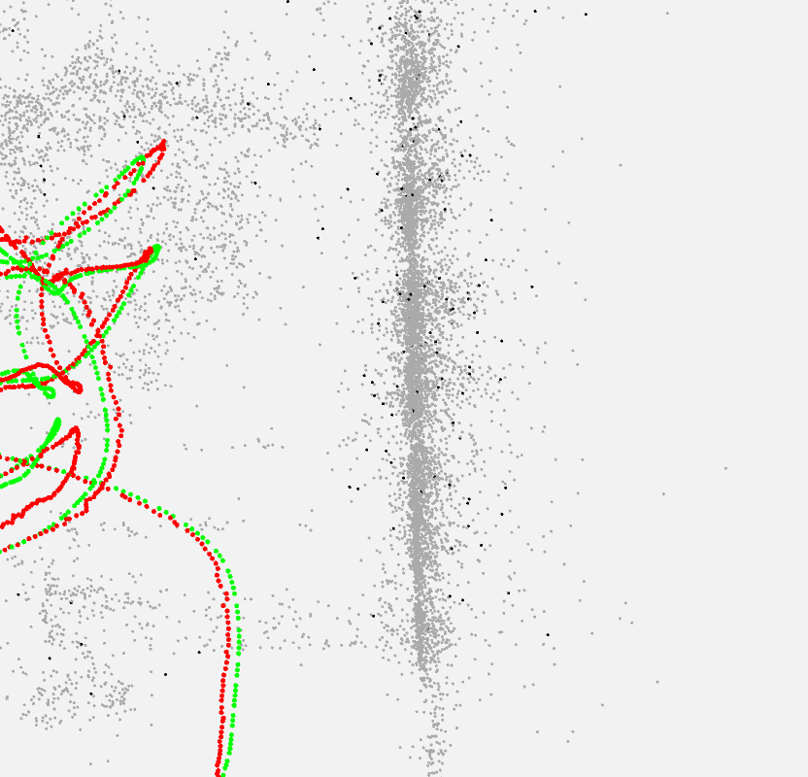
2 Evaluation
2.3 Visualization comparison
Maximum empty cells percentage: 42%
Exercise 5

Slide 36
3 Conclusion
1. Use Lucas and Kanade Optical Flow method to replace normal feature matching.
2. Try different key framing strategies: use grid or only inliers.
3. Try different configurations (e.g. shape of grid, key points detection strategies)
4. Visualize the ground truth and estimated trajectories of camera
5. Evaluation

Slide 37
Q&A
Any question?

Slide 38
Thank you for your attention!

